Slide 1
PER RECTAL EXAMINATION

Slide 2
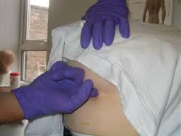
A rectal examination, commonly used for prostate exam, is an internal examination of the rectum performed by a physician or other healthcare professional.

Slide 3
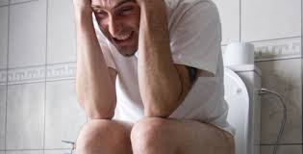
USES OF PR EXAMINATION
Diagnosis of rectal tumors and other forms of cancer
Diagnosis of prostatic disorders-tumors and benign prostatic hyperplasia
Estimation of the tonicity of the anal sphincter- in case of fecal incontinence or neurologic diseases, including traumatic spinal cord injuries
In females, for gynecological palpations of internal organs

Slide 4
For examination of the hardness and color of the feces- in cases of constipation and fecal impaction
Prior to a colonoscopy or proctoscopy
To evaluate hemorrhoids
In newborns to exclude imperforate anus
Anal bruising, and foreign objects in the rectal cavity.

Slide 6
Fistula in ano

Slide 7
Hemorrhoids

Slide 8
Polyps

Slide 9
Rectal prolapse

Slide 10
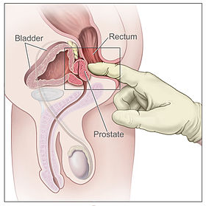
PARTS PALPABLE BY PR(MALE)
Bulb of the penis
The urogenital diaphragm
The anorectal ring and other nearby anatomical
landmarks.
Prostate

Slide 11
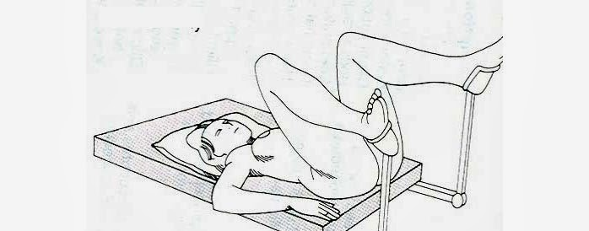
POSITIONS
Lithotomy position- the patient is supine with the legs drawn in toward the trunk and the knees allowed to fall out to the side-to examine the pelvic organs in women.

Slide 12
The lateral decubitus or Sim's position-The patient lies on the left side with the buttocks near the edge of the examining table or bedside with the right knee and hip in slight flexion.

Slide 13
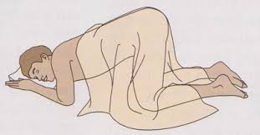
The proctologic (knee–chest or prone jackknife) position -to examine the perineum and rectum properly. In this position, the patient can easily undergo further studies such as anoscopy and sigmoidoscopy because of easier access to the anorectum.

Slide 14
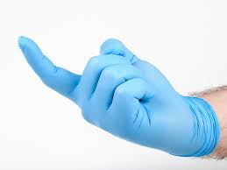
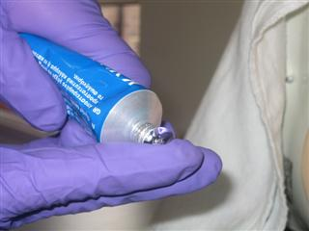
EQUIPMENTS
Incontinence sheet
Non-latex disposable gloves
Gauze swabs
Lubricating jelly
Towels

Slide 15
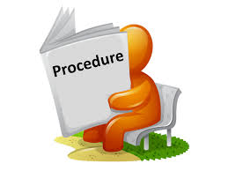
PROCEDURE
Take consent from the patient & explain the procedure
Inspects the buttocks for fistulous tracts, the skin tags of hemorrhoids, excoriations, blood, and rectal prolapse.
Ask the patient to bear down to check again for rectal prolapse.
Apply firm pressure on the ischial tuberosities in order to evaluate early abscess or fistula.

Slide 16
To assess neuromuscular integrity,first, scratch each side of the buttocks with the gloved finger to elicit the superficial anal reflex (the anal "wink")
Next, insert the gloved & lubricated finger gently into the rectum.
Ask the patient to contract the sphincter muscle- evaluate the anterior contraction of the puborectalis muscle and the contraction of the external anal sphincter.
When the patient relaxes, push the puborectalis muscle posteriorly- note the relaxation of the internal anal sphincter.
Ask the patient to bear down expelling the examining finger, causing the puborectalis muscle to move posteriorly and the internal anal sphincter to relax.

Slide 17
To assesses anatomic integrity, put the gloved finger into the rectum, and the entire circumference of the rectum is systematically palpated in two stages.
The first stage involves the area 1 to 2 cm beyond the external sphincter (the length of the fingerpad)
The second stage deals with the remainder of the rectum within reach of the examining finger, about 7 or 8 cm. Attention should be given to the presence of masses, tenderness, hemorrhoids, fissures, ulcers, and the color and consistency of the stool, with special emphasis on the posterior rectal shelf.
In men, the prostate, its size, consistency, and presence of nodules should be noted

Slide 18
ADVANTAGES
Examination of the rectum will point the physician in the proper diagnostic direction.
Obviates the need for expensive and unnecessary laboratory and/or radiologic evaluation.
Before the advent of serum prostate-specific antigen(PSA) testing in 1986, the digital rectal examination was the sole method of screening men for prostate cancer.

Slide 19
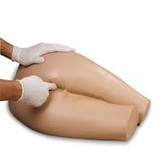
The diligent, conscientious, and thorough physician will make the rectal examination a necessary part of a complete patient evaluation. An anonymous quote is relevant: "For most diagnoses all that is needed is an ounce of knowledge, an ounce of intelligence, and a pound of thoroughness."

Slide 20
DISADVANTAGES
The procedure takes too much time
Causes discomfort to the patient
Not aesthetically pleasing

Slide 21
CONTRAINDICATIONS
Lack of valid consent or if a patient refuses
If the patient has recently undergone rectal or anal surgery or trauma

Slide 22
We should be cautious…
We must be cautious in case of acute bacterial prostatitis or prostatic abscess
Be cautious while examining infants & young children
Should be done in a safe position in case vasovagal syncope should occur
Has active inflammatory bowel disease

Slide 23
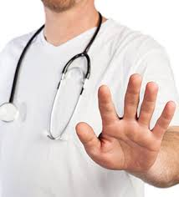
We should be cautious…
Has had recent radiotherapy to the pelvic area
Has rectal or anal pain
Has obvious rectal bleeding
Has spinal cord injury

Slide 24
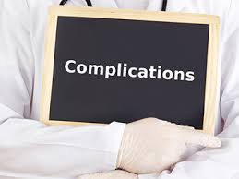
Discomfort post examination
Tearing of the perianal skin or mucosa
Abrasion or tearing of hemorrhoidal tissue
Infection post procedure is possible, but very rarely occurs

